Slide 1

IoT + ML Based Smart Irrigation System
Ajin biju

Slide 2
Introduction
“This project is an IoT + ML based Smart Irrigation System using ESP32 that automates watering based on soil and weather conditions. It helps save water, reduces manual effort, and supports smart farming.

Slide 3
Components Used
ESP32 Development Board
Soil Moisture Sensor
DHT22 (Temp & Humidity Sensor)
Relay Module
Water Pump
Breadboard, Jumper Wires, Power Supply

Slide 4
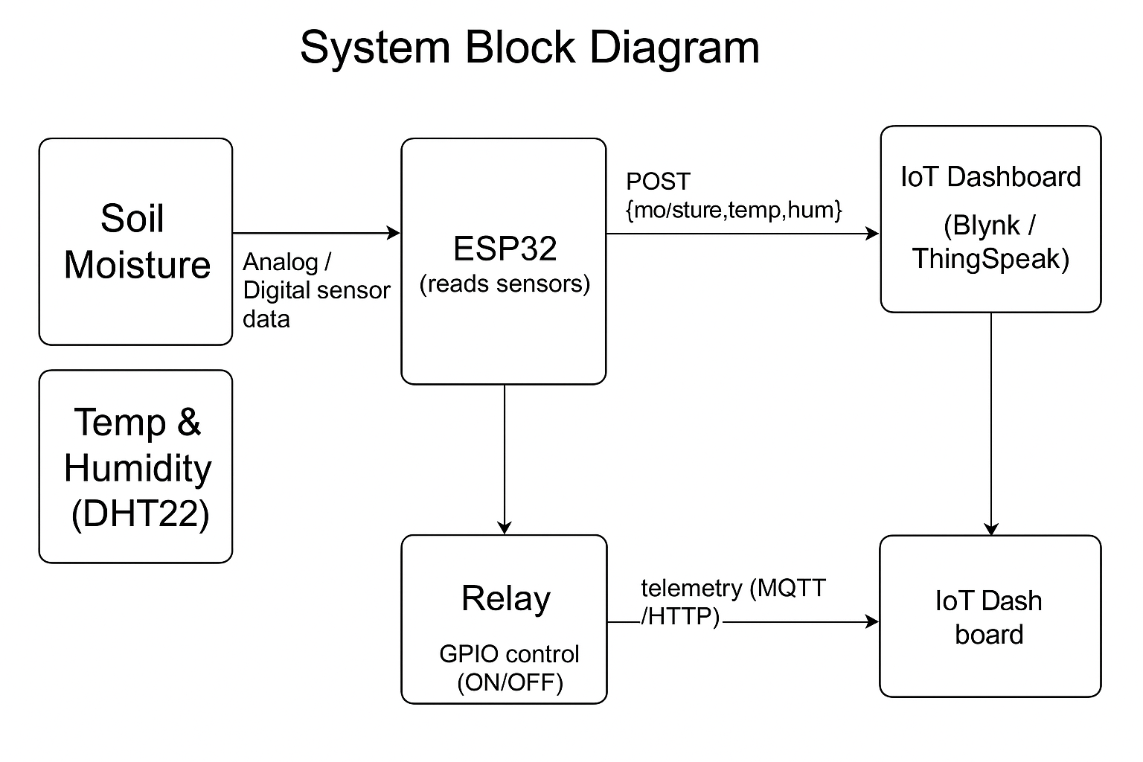

Slide 5
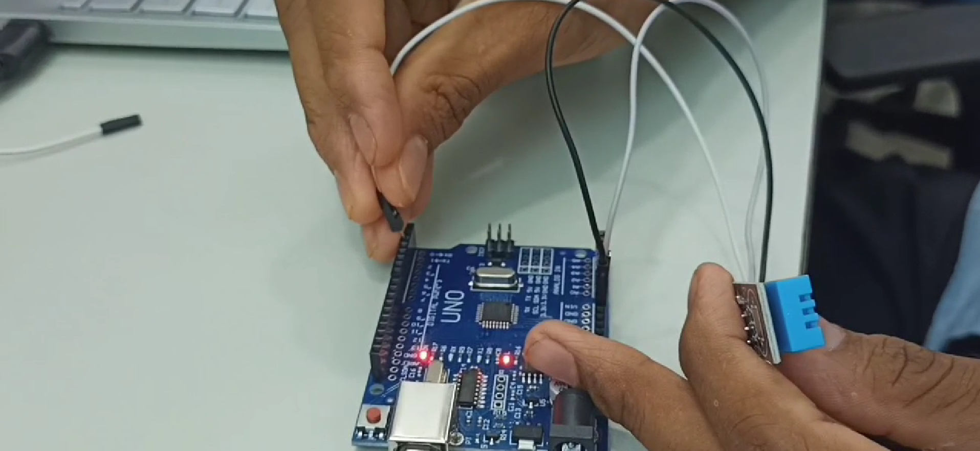

Slide 6
The dashboard is created in Blynk IoT (works on both mobile app and web browser).
It shows real-time sensor values like soil moisture, temperature, and humidity.
It also has a Pump Control switch so users can turn the pump ON/OFF from anywhere.
The ESP32 sends data to the cloud, and the dashboard updates live.
This makes irrigation smart and remote-controlled
DASHBOARD

Slide 7
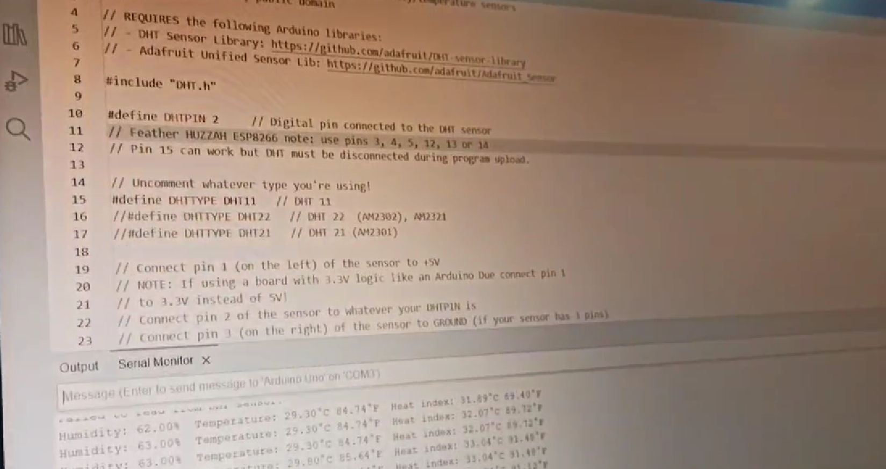
CODE

Slide 8
THANKYOU

